Slide 1
Robert Mazza, Inc. (Mazza)
Who are we, and what do we do?

Slide 2
Who are we, and What do we do?
We are a family owned and operated wine, beer, and spirits manufacturer. Robert (Bob) Mazza and his brother Frank founded Mazza Vineyards in 1972; turning the family farm into a winery taking advantage of new laws allowing wine to be made from PA fruit.
Started with a single vineyard in ‘72, we now are comprised of 3 wineries (Mazza Vineyards, South Shore Wine Co., and Mazza Chautauqua Cellars), a Distillery, and brewery (Five & 20 Spirits and Brewing). A large portion of our operations also involve contract beverage production, blending and bottling.

Slide 3
Who’s Who in the Mazza Family?
Bob is our founder,owner and President. You will see him around all locations frequently.
Bob’s wife, Kathie Mazza (co-owner) is involved in the business as well, handling banquet hall events, and working behind the scenes on a variety of fronts
Mario Mazza (Bob and Kathie’s son) is co-owner, Vice President, and General Manager. He never stops! Constantly working on all things Mazza. He heads up the winemaking team, as well as managing all aspects of everything that we do.
Vanessa Mazza (Bob and Kathie’s daughter) is co-owner and creative director. She also works on several other aspects of the business from social media to customer service, to booking our bands, and a plethora of other things.

Slide 4
What do we make??
Wine
Beer
Cider
Distilled Spirits

Slide 5
WINE….What is Wine?
Wine is an alcoholic beverage made with the fermented juice of grapes.
Technically, any fruit is capable of being used for wine (i.e., apples, cranberries, plums, etc.), but if it just says “wine” on the label, then it’s made with grapes.

Slide 6
SPIRITS AND BEER
A liquor, or distilled spirit, is an alcoholic beverage distilled from grains, fruits, or other fermentable ingredients. Much stronger than beer and wine, distilled spirits include brandy, gin, rum, tequila, whiskey, vodka, and various flavored liqueurs.
In the broadest sense, “beer” is any alcoholic beverage made by the fermentation of grain, just as wine is any alcoholic beverage made by the fermentation of fruit. In the vast majority of the world’s beers, the grain base is barley.

Slide 7
All 3 of our wineries are located in the: Lake Erie AVA
What is an AVA?
An American Viticultural Area is a designated wine grape-growing region in the United States, providing an official appellation for the mutual benefit of wineries and consumers. Wikipedia
Some other well known AVAs:
Napa
Columbia River
Willamette Valley

Slide 8
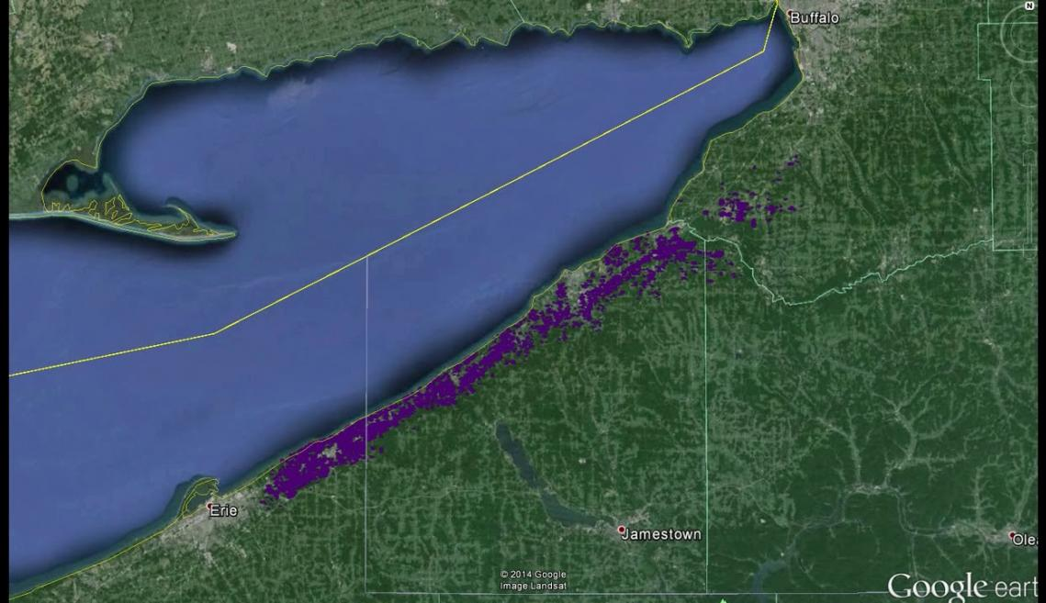

Slide 9
MAZZA VINEYARDS
Since their first vintage in 1973, Mazza has been successfully blending the ancient art of winemaking with the most modern techniques and equipment. Fine wines are born from the highest quality wine grapes, and the team at Mazza works intimately with select growers in the Lake Erie Wine Region to craft only the finest wines at their winery, which is one of the largest producing wineries in the state.
Since its beginning, the brand and its wines have been inspired and influenced by a diverse lineage of international winemakers from across the globe. Their clean and experimental approach to winemaking has resulted in a fascinating wine list that ranges from crisp and pristine to robust and fruit-forward. Nearly every vintage features their signature Ice Wine of Vidal Blanc, showcasing the family’s legacy of trailblazing winemaking and the distinct effects of Lake Erie’s cold climate.
Original location, and main wine production facility

Slide 10
WINES FROM MAZZA VINEYARDS
THE TRIBUTE COLLECTION “Seek Excellence”
While our wine list has evolved from our first vintage in 1973, this core portfolio of classic varieties has served as its foundation decade over decade, celebrating the wines that we’ve continuously produced and continue to perfect.
Chardonnay, Pinot Grigio, Riesling, Vidal Blanc, Merlot, Cabernet Franc, Port, and Cream Sherry
THE VINEYARD COUNTRY COLLECTION
Six easy-sipping sweeter wines highlighting some of the region’s signature grape varieties.
Country Blush, Pink Catawba, Country Red, Niagara Concord, Victorian Holiday

Slide 11
THE LA FAMIGLIA COLLECTION
There’s a place for tradition in winemaking, and there’s a place for experimentation. This eclectic and ever-evolving collage is a toast to the latter, reflecting the impressively diverse and intentionally international lineage of winemakers who poured their hearts and souls, talent and techniques, into our wines.
Tesoro, L’Anima, Appassionato, Late Harvest Vidal Blanc, Ice Wine of Vidal Blanc.

Slide 12
MAZZA CHAUTAUQUA CELLARS
New York State’s first combination winery, distillery, and brewery
Mazza Chautauqua Cellars might be our family’s third location in the Lake Erie AVA, but it’s the first of its kind in New York State. Sharing a home with our sister distillery and brewery, Five & 20 Spirits & Brewing, its signature patio space is an appropriately laid-back setting to enjoy the beverage of your choice, along with live music, lawn games, and a rotation of guest food purveyors during the warmer months.
Our wine list here is an intentional curation of bottles that pay homage to the agricultural bounty that surrounds us, including refined European varietals and easy-sipping native varietals
“The Westfield Wonder”. Winery, Brewery, and Distillery all under one roof

Slide 13
MCC WINE COLLECTIONS
THE TRAVELER SERIES
Seek Nuance
Fine European varietals that exemplify the parallel terroir and growing conditions between the Lake Erie AVA and similar winemaking regions around the world
Chardonnay, Pinot Grigio, Riesling, Riesling (Nutt Rd. Vineyard), Vignoles, Gewurtztraminer, Merlot, Lemberger, Forte of Cabernet Franc.
THE PATIO SERIES
A bright and playful trio of easy-sipping wines that show off the region’s sweeter, fruitier varietals
Niagara, Lighthouse point Rose, concord

Slide 14
NY operations timeline:
2004
construction begins in Mayville,NY
2006
MCC opens in Mayville
producing wines, and the first distilled spirits (grappa, Eaux de Vie, and grape spirit for our fortified wines – port, and sherry styles)
2011
first whiskey goes into barrel
2013
Five & 20 spirits launched, and new (current) location opens
2015
Five & 20 brewing launched, creating NY state’s first ever combination winery, distillery, and brewery – “The Westfield Wonder”

Slide 15
SOUTH SHORE WINE COMPANY
The South Shore Wine Company stands as a tribute to the Lake Erie AVA’s winemaking origins and storied heritage of sparkling wine production on the site of Erie County’s first commercial winery. The Mazza family restored the 19th century facility and its impressive Civil-War-era stone cavern, which is now home to an effervescent collection of bubbly bottles produced in traditional, contemporary, and experimental methods, alongside standout emerging varietals and lightheartedly sweeter selections.
2007- Mazza family purchased and renovated historic building, bringing back historic winery in name, and location.
Beautiful historic stone wine cavern housing all of our sparkling wines (a true sparkling wine house) as well as other quality offerings

Slide 16
SSWC WINE COLLECTIONS
THE COUPE COLLECTION
Seek Sparkle
This bright, bubbly line-up celebrates our region’s storied legacy of sparkling wine production. We honor that history –and that of our family – by combining traditional and progressive winemaking techniques for a truly effervescent tasting experience.
Pet Nat Riesling, Pet Nat Rose, Sparkling Riesling, Sparkling Chardonnay, Sparkling Pinot Noir.

Slide 17
THE DOLCE COLLECTION
Seek Joy
Juicy fruits and honey take center stage in this limited collection of sweet yet balanced wines.
Niagara, South Shore Rose, Concord, Cranberry, Blueberry, Honey Mead, Sangria

Slide 18
The Inner Circle
While traditional varieties get mass recognition, it’s the lesser-known varieties that are simply irresistible to the true wine lover. This portfolio was curated for the adventurous oenophile.
Gruner Veltliner, Unwooded Chardonnay, Traminette, Teroldego, Lemberger, Carmine, Zweigelt, Forte of Chambourcin

Slide 19
Other “Mazza” Brands
The Perfect Wines - Perfect Bubbly, Perfect Blanc, Perfect Rose, Perfect Red. Available at South Shore, and online.
The Bare Bones Wines – BB White, BB Rose, BB Red, BB Moscato. Available at Mazza Vineyards, Mazza Chautauqua Cellars, and online
Getaway Canned Wines – Getaway Bubbly white, Getaway Bubbly Rose, and Getaway Bubbly Red.
Be aware that we also make Check wines (Red, white, and rose), Nectar wines (all sweet wines)
These are largely available offsite (grocery stores, etc.). Not available at any of our physical locations

Slide 20
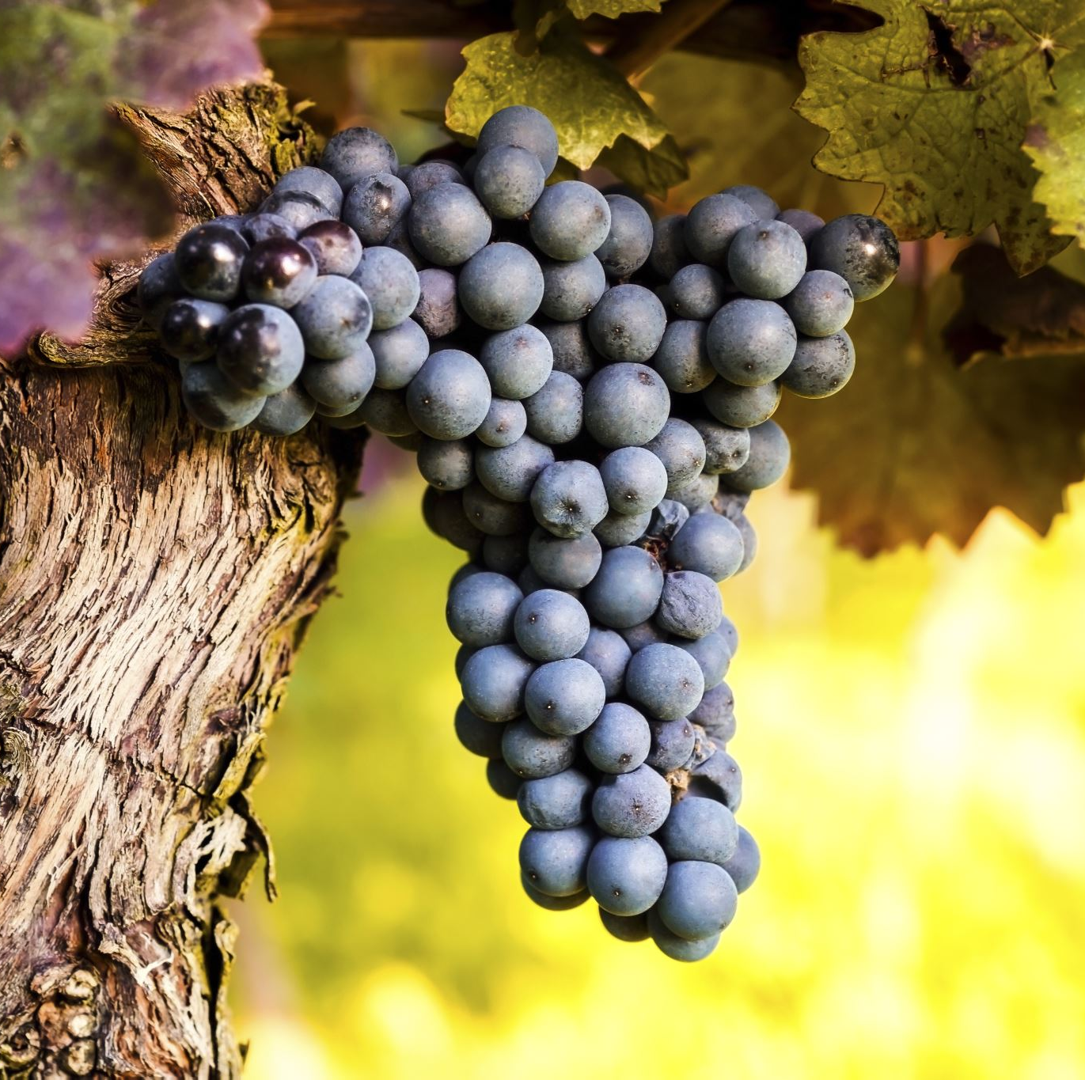
Basic wine production
Grapes are harvested, fermented and pressed (or pressed then fermented), sometimes aged, and then bottled

Slide 21
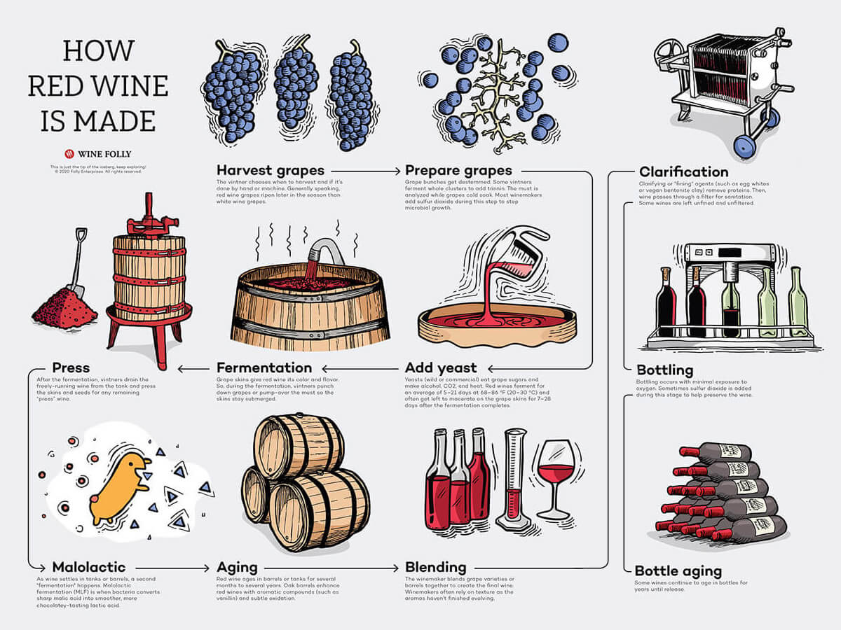

Slide 22
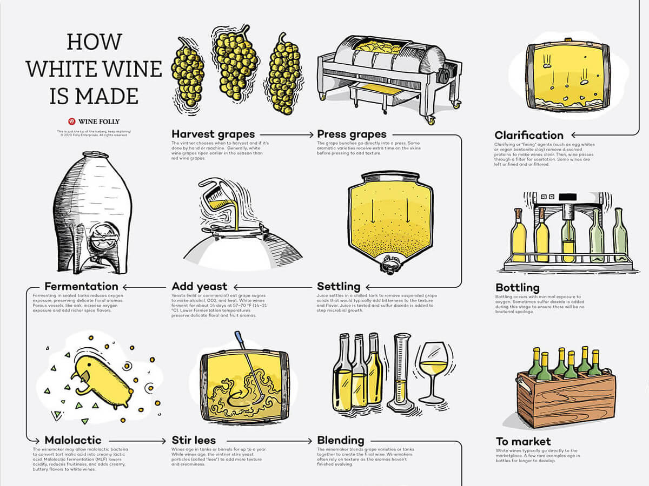

Slide 23
WINEMAKERS
Mario Mazza
General Manager, Co-Owner, and Vice President
With a Bachelor of Science in Chemical Engineering from Case Western Reserve University in Cleveland, OH – Mario went on to earn a Master’s in Enology from the University of Adelaide in Australia. While there, he gained experience in the Barossa Valley and in the Adelaide Hills. In addition to his early exposure to the family business, Mario has 15 years of experience in research & commercial winemaking, as well as sensory training including the PA Wine Quality Initiative. He has a passion for quality & excellence in both process & product.

Slide 24
WINEMAKERS
Matthew Herrera
Assistant Winemaker
Matt, originally from Western New York, earned his BSc in Molecular Biology from Defiance College and his MSc in the same from OSU. Between his undergrad and graduate programs, an opportunity to travel abroad brought him to wine regions across Europe and, with that, a lasting appreciation for the craft of winemaking. Since that time, Matt has become a Certified Sommelier, made his way through level 4 of the WSET program, and gained professional experience as a wine buyer, beverage program director, and finally reaching his ultimate goal of winemaking, proudly joining the team at Mazza Vineyards as the assistant winemaker.

Slide 25
WINEMAKERS
Guillermo Lombardo
Consulting winemaker. Works predominantly remotely from his home in Argentina.
Very involved in entire winemaking process

Slide 26
Basic spirit distillation
A mash of grains (or fruits or other sugars in some instances) are cooked into a mash and fermented.
Resulting liquid is distilled to separate alcohol from remaining liquid. Distillation is the process of separating alcohol from water via evaporation and condensation. The base alcohol is heated, and certain parts of it are captured. This process purifies and concentrates the remaining alcohol

Slide 28
HEAD OF DISTILLING AND BREWING OPERATIONS
Joe Nelson
With hands-on experience since 2008 and several technical short courses for distilling, Joe has found his passion and his niche in distillation. His repertoire has grown along with his knowledge and skills; from a previous venture in brewing beer, it has expanded into all areas of fermentation, including mead, wine, spirits & whiskey.

Slide 29
BEER
By simplest definition, Beer is an alcoholic beverage made from fermenting a mash of grains.
Hops is generally used to add flavor
Many other techniques are also used in beer production (ex: barrel aging, fruit, and other flavor additions)

Slide 30
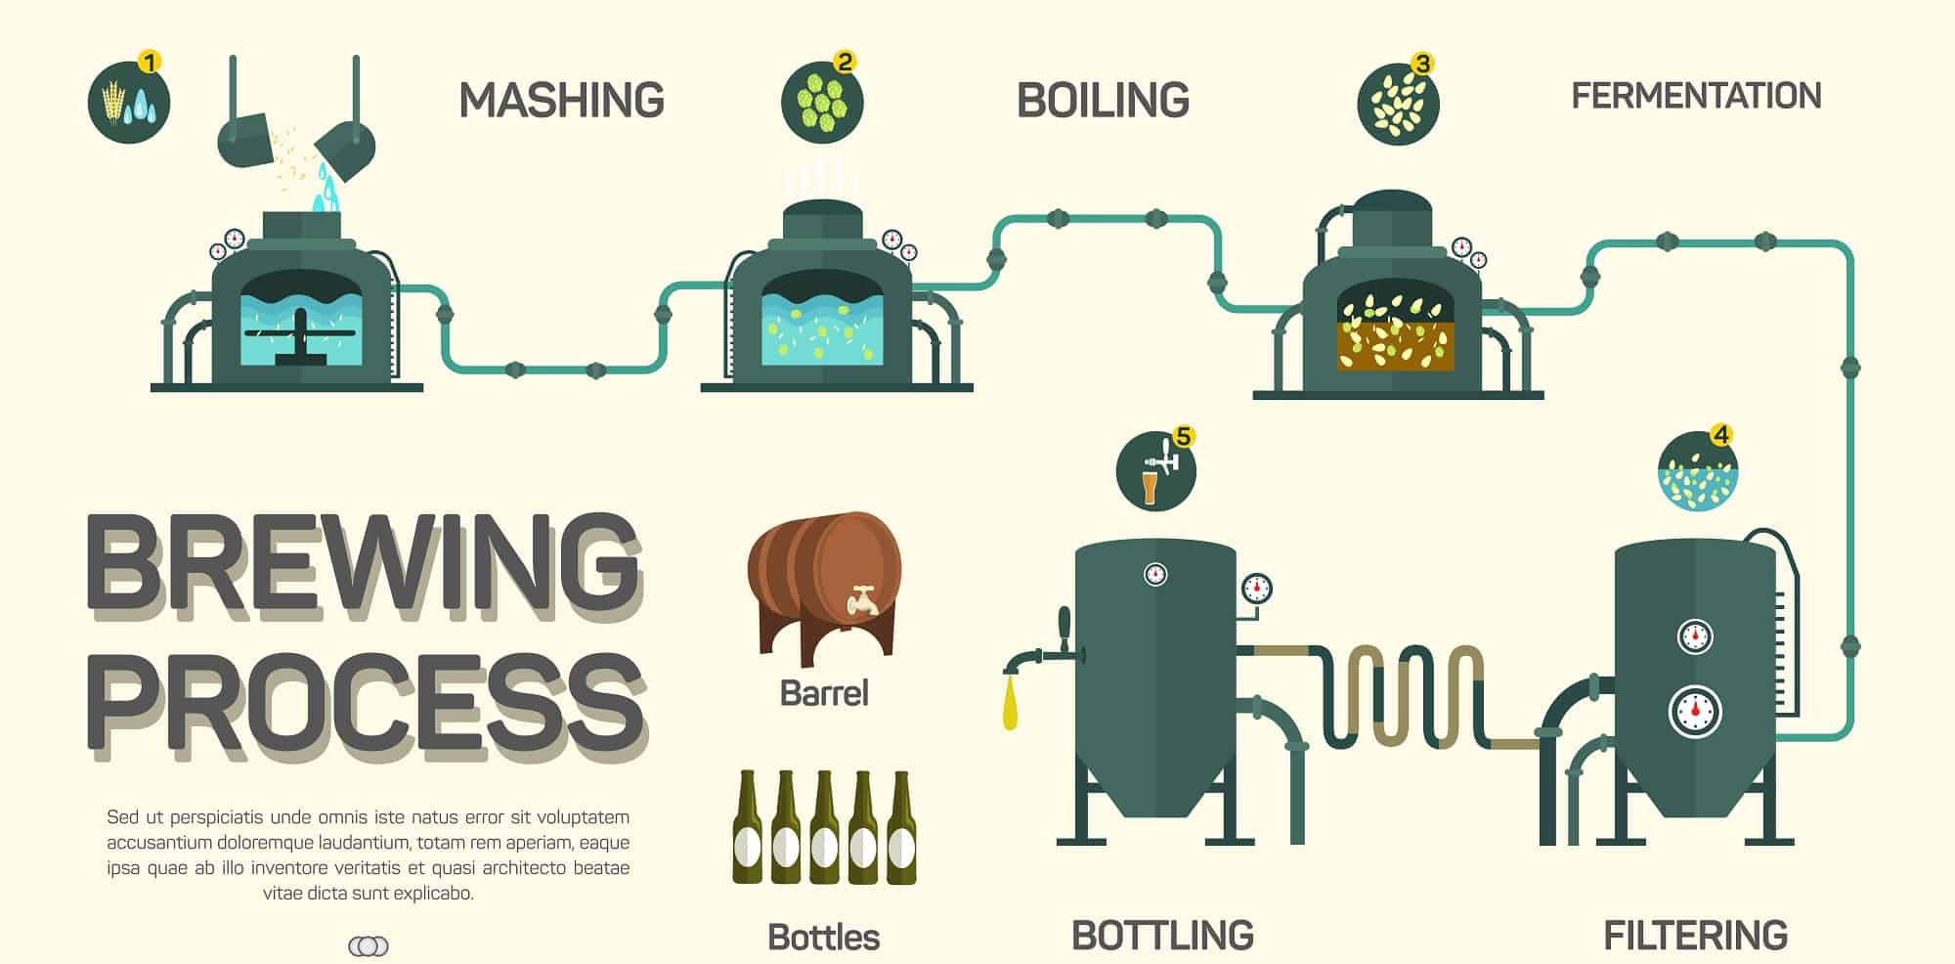

Slide 31
BREWER
Nelson DaSilva

Slide 32
WEBSITE AND SOCIAL LINKS
www.enjoymazza.com
www.five&20.com
@mazzawines FB, TW, IG, Youtube
@fiveand20 FB, TW IG

Slide 33
RESOURCES – PLEASE TAKE TIME TO LOOK AT THESE WEB PAGES AND LINKS.
www.enjoymazza.com – very comprehensive landing page to investigate all things Mazza
What is Wine? A Beautiful Explanation | Wine Folly
Wine Sweetness Chart | Wine Folly
What Are Tannins In Wine? | Wine Folly
What Is a Liquor or Distilled Spirit?
What is beer?
Styles - All About Beer
About the Lake Erie Viticultural Area | CALS

Slide 34
Knowledge is Power!
Booze is interesting! Please take the time to learn a thing or two about the products that we produce.
The more you know, the more confident you will be discussing our products with our guests
We are in the business of creating enjoyable experiences for people who visit our locations. Knowing what you are talking about really helps to create a great experience for you, and for our guests, and our company as a whole.
This is a fun business! Embrace it!

Slide 35
Feel free to reach out to me with any questions! blaine@mazzawines.com 406-581-2387
Blaine Ballard
Brand Ambassador
Blaine is a North East native who began working in hospitality at a young age. He bartended through college, gaining experience and a passion for hospitality that opened doors for bartending, bar manager, and beverage director positions at restaurants and resorts locally and across the country. Blaine’s talent for curating wine lists and cocktail menus and developing bar programs has provided opportunities at establishments large and small. A true passion for wine and spirits continues to drive him in his current position as brand ambassador for our family of wineries, distillery, and brewery.

