Slide 1
Sparkling Wine(s) in the Lake Erie Region, and beyond
A look at the history of sparkling wine worldwide, in North America, and right here in, and around the Lake Erie AVA.

Slide 2
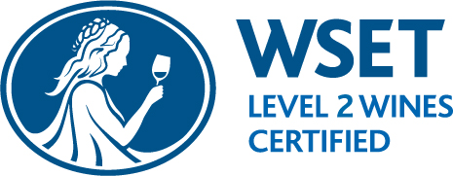
Blaine Ballard Brand Ambassador Mazza Wines/Five & 20 Spirits and Brewing
Blaine is a North East native who began working in hospitality at a young age. He bartended through college, gaining experience and a passion for hospitality that opened doors for bartending, bar manager, and beverage director positions at restaurants and resorts locally and across the country. Blaine’s talent for curating wine lists and cocktail menus and developing bar programs has provided opportunities at establishments large and small. A true passion for wine and spirits continues to drive him in his current position as brand ambassador for our family of wineries, distillery, and brewery.

Slide 3
Mazza Vineyards
Our legacy brand highlights the expertise and expressiveness of our international lineage of winemakers.

Slide 4
Mazza Chautauqua Cellars
Refined European varietals and easy-sipping native ones showcase the depth of the region’s agricultural diversity.

Slide 5
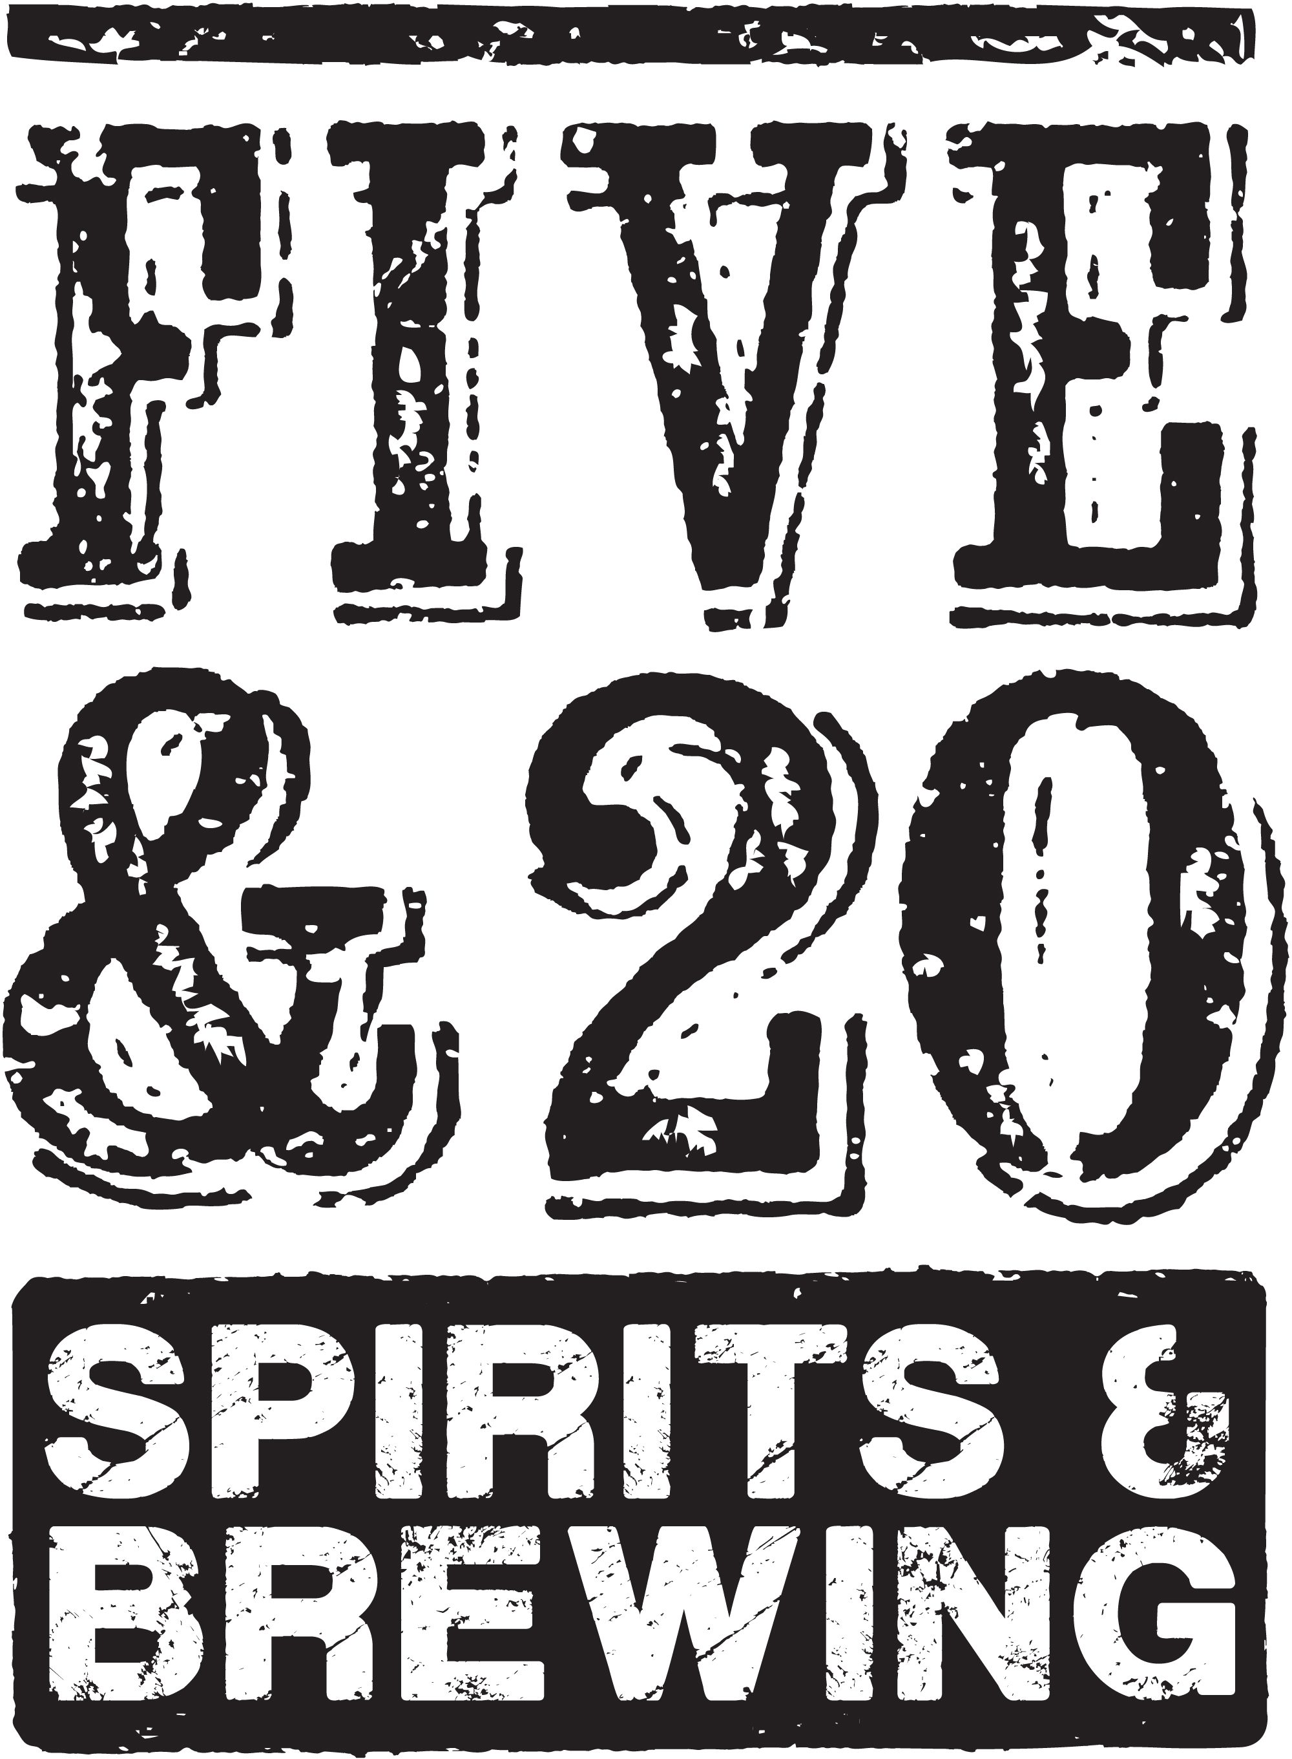
Five & 20 Spirits and Brewing
Craft beers and spirits born of wine.

Slide 6
South Shore Wine Company
Sparkling wines take center stage alongside standout emerging varietals.
Dedicated “Coupe Collection” – A nod to the pioneers of the wine industry along the South Shore of Lake Erie
*A true “sparkling house” in the Lake Erie AVA

Slide 7
Celebratory wines in a historic setting
South Shore Wine Company is locally known for its historic stone cavern tasting room. Built in the 1860’s in the style of traditional French wine caverns, the stone cellar is a unique (and Instagrammable!) setting for sipping some of our region’s most toast-worthy wines. A robust selection of bubbly, made in traditional, contemporary, and experimental methods, pays homage to our region’s storied history of sparkling wines.

Slide 8
Sparkling Wine Defined:
Any wine with significant levels of Carbon Dioxide in it, making it fizzy.
We are going to focus on 4 methods of making sparkling wine, and their history worldwide, and right here at home in New York and The Lake Erie AVA.
* Méthode Champenoise
* Pétillant Naturel (a.k.a. “Pet-nat”)
* Charmat
* Forced Carbonation

Slide 9
EARLY SPARKLING HISTORY
Some of the first recorded mentions of sparkling wine were by Benedictine Monks in St. Helaire, France as early as 1530. They had stumbled upon some bottles going through secondary fermentation, and this “fault” ended up being a fortunate accident creating this desirable wine from the region Blanquette de Limoux

Slide 10
Early Sparkling wines of Limoux were likely an accident:
Fermentation may have been halted or slowed by cooler winter temps. Spring warm-up would have re-started fermentation in the bottle leading to carbonation.
This method of carbonation is known as the Ancestral, or Pétillant Naturel (a.k.a. “Pet-nat”) method
Note: In this region, they now mainly use the Traditional Method, or Methode Champenoise.

Slide 12
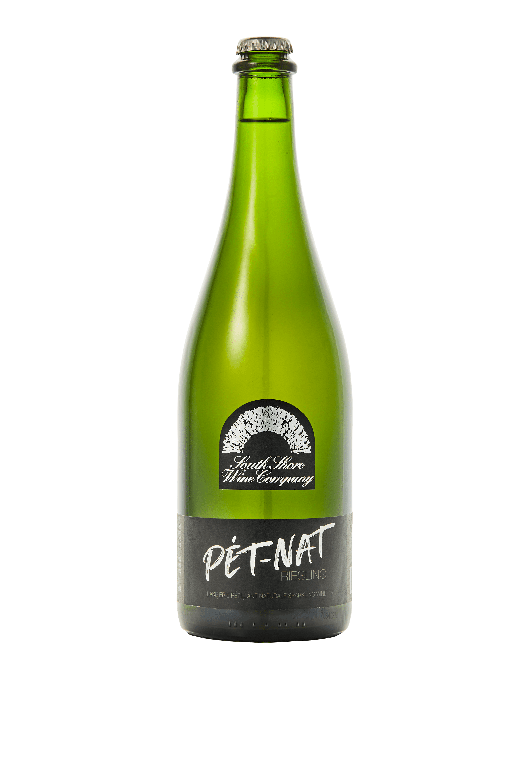
Vintage: Non-Vintage
Appellation: Pennsylvania
Residual Sugar: 0.5% Alcohol: 11%
Varieties: Riesling (100%)
Winemaking/Ferment notes: This Clone 90 Riesling was bottled when partially fermented, in the Pétillant Naturale method, creating natural carbonation. Some lees and sediment remain, chill upright if you'd like to control the sediment before serving Cellaring potential: Enjoy young, also benefits from careful cellaring
pH: 3.07 TA: 9.5 g/L
Vineyards: Moorhead Farms Harvest Dates: 10/14/19
Food pairing(s): Fried Chicken; Crisp apple wedges and a soft, mild cheese like well-ripened Brie

Slide 13
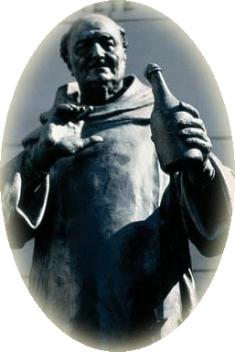
Moving through history to the term most typically associated with Sparkling wine:
CHAMPAGNE
In the early 1700’s, a Benedictine monk by the name of Dom Pierre Pérignon had observed the sparkling wines of Limoux and brought the effervescent style to the Champagne region. Sadly, he died in 1715 before any commercial production happened, but he is credited as the “Father of Champagne”.
1729 – Ruinart, Champagne’s oldest sparkling house is founded
1772 – Veuve Cliquot founded. Madame Cliquot invented the Riddling process to remove yeast and lees after secondary fermentation, creating the Traditional Method of making sparkling wine méthode champenoise

Slide 14
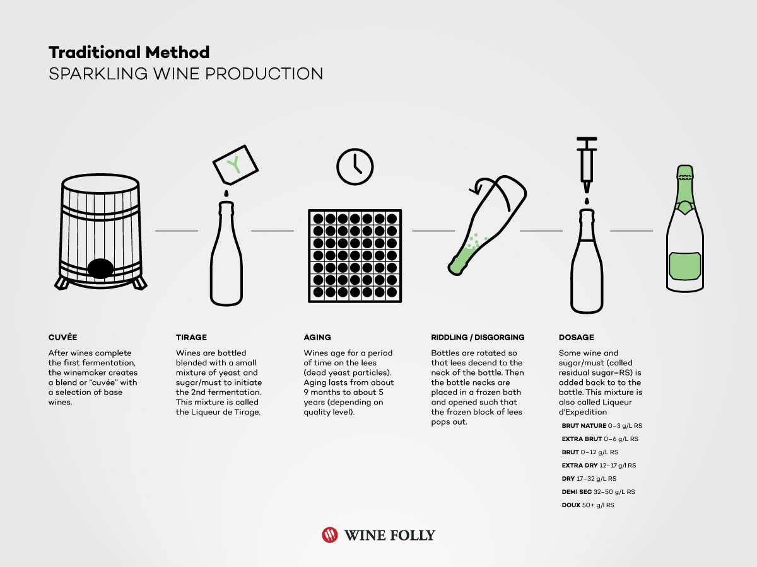
Many sparkling wines produced using this method:
Champagne, Cremant, Cava, Sekt, etc.

Slide 15
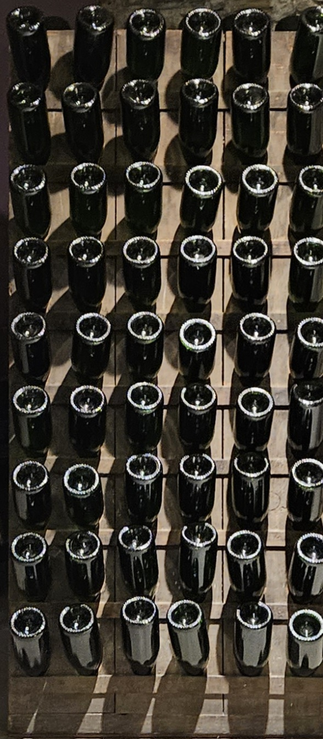
Riddling Rack & Remuage

Slide 16
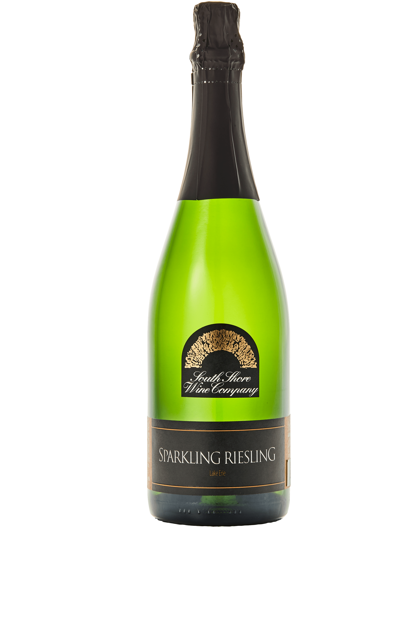
Vintage: Non-Vintage
Appellation: Pennsylvania
Residual Sugar: 1% Alcohol: 12%
Varieties: Riesling (100%)
Winemaking/Ferment notes: Our Sparkling Riesling is bottle fermented using the Méthode Champenoise (traditional method). This wine is a dry, medium-bodied sparkling Riesling brimming with lush fruit, bright acidity, and a snappy finish, with delicious notes of green apple and concentrated stone fruit on the palate
Cellaring potential: 1-2 years - Best consumed young
pH: 3.05 TA: 7.7 g/L
Vineyards: Moorhead Farms Harvest Dates: 10/13/20
Food pairing(s): Crisp apple wedges, soft, mild cheeses like wellripened Brie, toasted brioche, spicy ramen
Dietary Notes: Vegan, Gluten Free
Awards: PA Wine Excellence Top 10

Slide 17
The 1750’s bring the first mention of sparkling wines being produced in Italy. They were using the ancestral method up until 1895 when they invented the: CHARMAT (or Tank) Method of sparkling production

Slide 18
In the Charmat method, Wines undergo a secondary fermentation in a large pressurized tank. This technique reduces labor (no need for riddling many bottles), leading to reduced production costs. This made a more affordable sparkling wine while still holding onto quality.
Prosecco is the best known wine using this method.

Slide 19
Another method of creating bubbles in wine worth mentioning is Forced Carbonation:
A still wine is produced using normal fermentation.
Upon completion of fermentation, the base wine blend is transferred to a special pressurizing tank
The resulting pressurized wine is then bottled and sealed.
This process differs from the others that we have discussed in that there is no secondary fermentation. The resulting sparkling wine retains the quality of the base wine, and a distinct freshness of aromas and flavors. This process further reduces production costs allowing the producer to offer quality bubbles at an affordable price.
We make an excellent forced carb wine called The Perfect Bubbly in our “Perfect” series of wines.

Slide 20
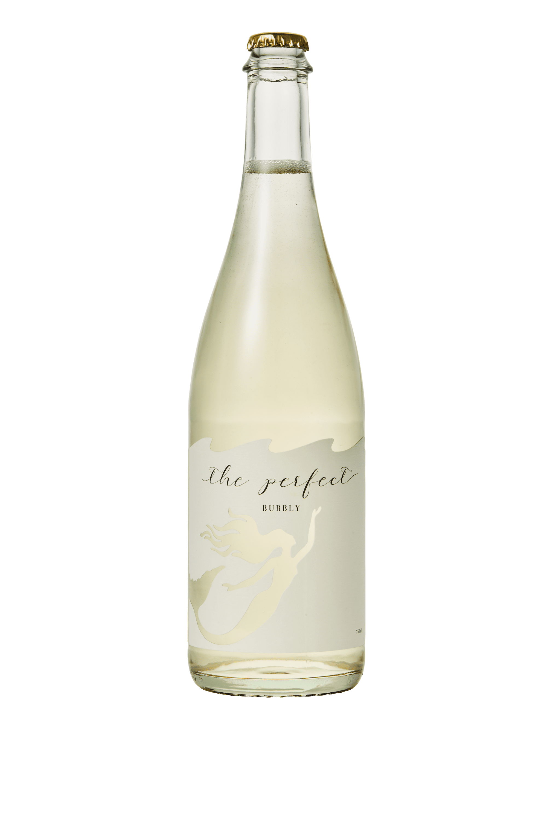
APPELLATION: LAKE ERIE
RESIDUAL SUGAR: 1. 6 %
ALCOHOL: 12%
VARIETIES: VIDAL BLANC, CAYUGA WHITE, RIESLING, TRAMINETTE
WINEMAKING/ FERMENT NOTES: COOL FERMENTED IN STAINLESS PRIOR TO CAREFUL BLENDING.
RESIDUAL SWEETNESS BRIGHTENS THE FRUIT AND IS BALANCED BY LIVELY CARBONATION.
PH: 3. 6 TA: 6.2 G/L
VINEYARD(S): VARIOUS VINEYARDS THROUGHOUT THE LAKE ERIE APPELLATION
FOOD PAIRING(S): SEAFOOD, SPICY FARE, OR PERFECT ON ITS OWN.
BEVERAGE TESTING INSTITUTE WORLD WINE PACKAGING COMPETITION BEST LABEL SERIES, 2021

Slide 21
Sparkling Wines in the US / North America
In The US, California is definitely a big player in the sparkling wine game; however, the First US sparkling wines came from close to home in the Cincinnati, OH area from a man named Nicholas Longworth

Slide 22
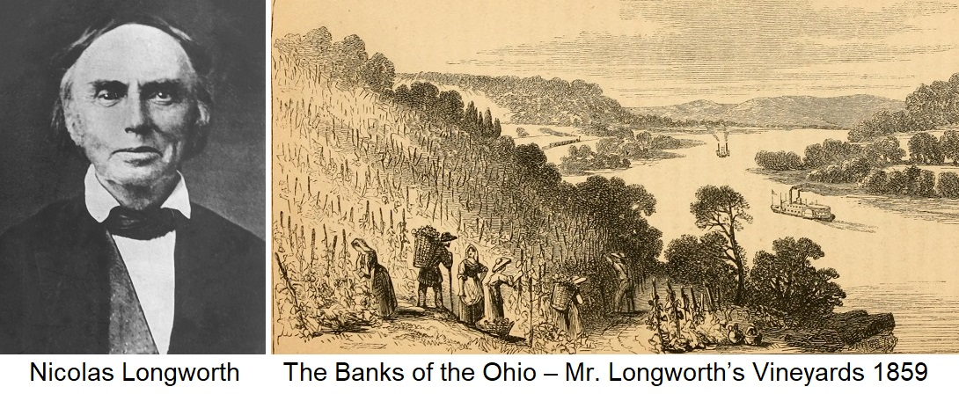

Slide 23
Nicholas Longworth
Longworth was a Lawyer, and temperance movement supporter from Cincinnati, OH. He was looking for an alternative to the preferred Boozy Whiskey of the time.
He began making wines from an early Labrusca/Vinifera hybrid grape, Catawba. We still use Catawba in this region.
The wines were, originally, slightly off putting, and less than desirable
Longworth experimented and ended up removing skins before fermentation resulting in a sweet rosé style of wine – much improved from the musky wines he was previously making.
In 1842, an accidental sparkling wine resulted when some stored bottles spontaneously fermented. Turned out to be a “happy accident”

Slide 24
Longworth’s “Happy accident”, and unhappy demise
Encouraging results from an accidental fermentation led Mr. Longworth to seek guidance on intentional sparkling wine production from French winemakers.
Resulting wines were met with great acclaim, and placed on wine lists in NYC, Chicago, and beyond. He was said to be annoyed when his wines were listed with “inferior Champagnes” and the like.
People took notice, and began making intentional sparkling wine throughout the region.
By 1859, OH was the largest wine producer in the US (over 100,000 bottles/yr.)
In 1860, a horrible rash of disease struck destroying most vines in the area. Sparkling Catawba from OH faded, but Nicholas Longworth is remembered as the father of sparkling wine iin the US

Slide 25
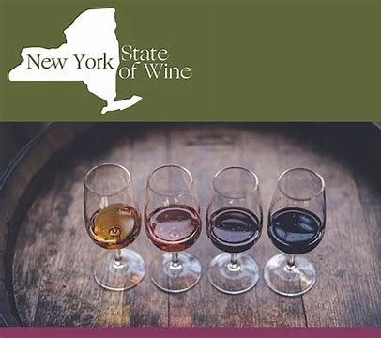
By 1900, With hybrid grape varieties and grafting of Vinifera vines to native root stock, New York became the nations leader in US sparkling wine production, (with Ohio being second) up until the onset of Prohibition. Prohibition.

Slide 26
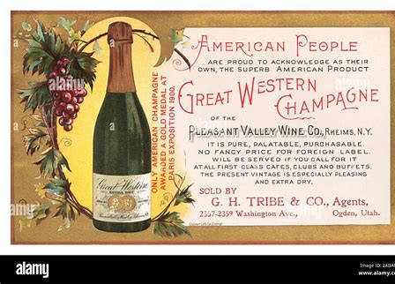
1860 – Pleasant Valley Wine Co. Founded – They were making noteworthy sparkling wines, and began marketing their sparkling collection as “Great Western Champagnes”. This led to the formation of the Great Western Wine Co.in 1870

Slide 27
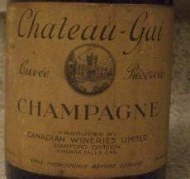
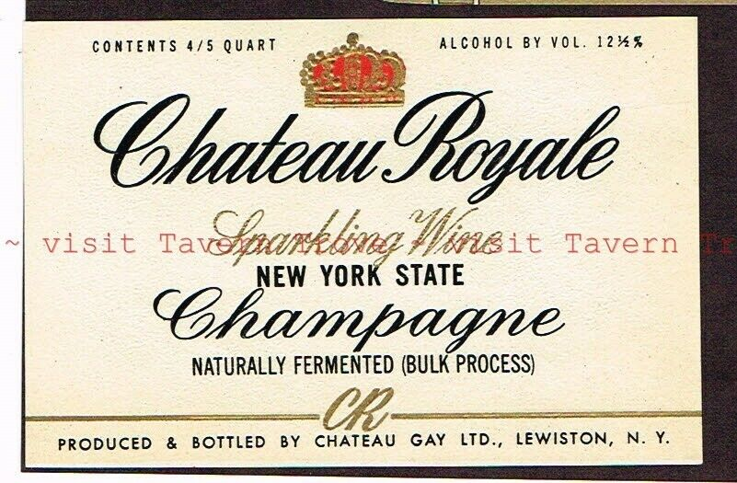
1928 – Chateau Gai – Niagara Falls, Canada
1st winery in the area to use Charmat method
1934 – Chateau Gai opened Chateau Gay in Lewistown, NY bringing Charmat production to US

Slide 28
1955 – Bright’s (formerly Niagara Falls) Wine Company produced the first commercial vinifera sparkling wine to be produced in Eastern North America. It was a Pinot Noir.
1978 –Canandaigua Wine Company introduces J. Roget brand of sparkling wine. Large production. Very popular. That company has since morphed into Constellation Brands (one of the largest wine and spirits brands in the world)
1978 – Bully Hill introduces first Champagne style wine.

Slide 29
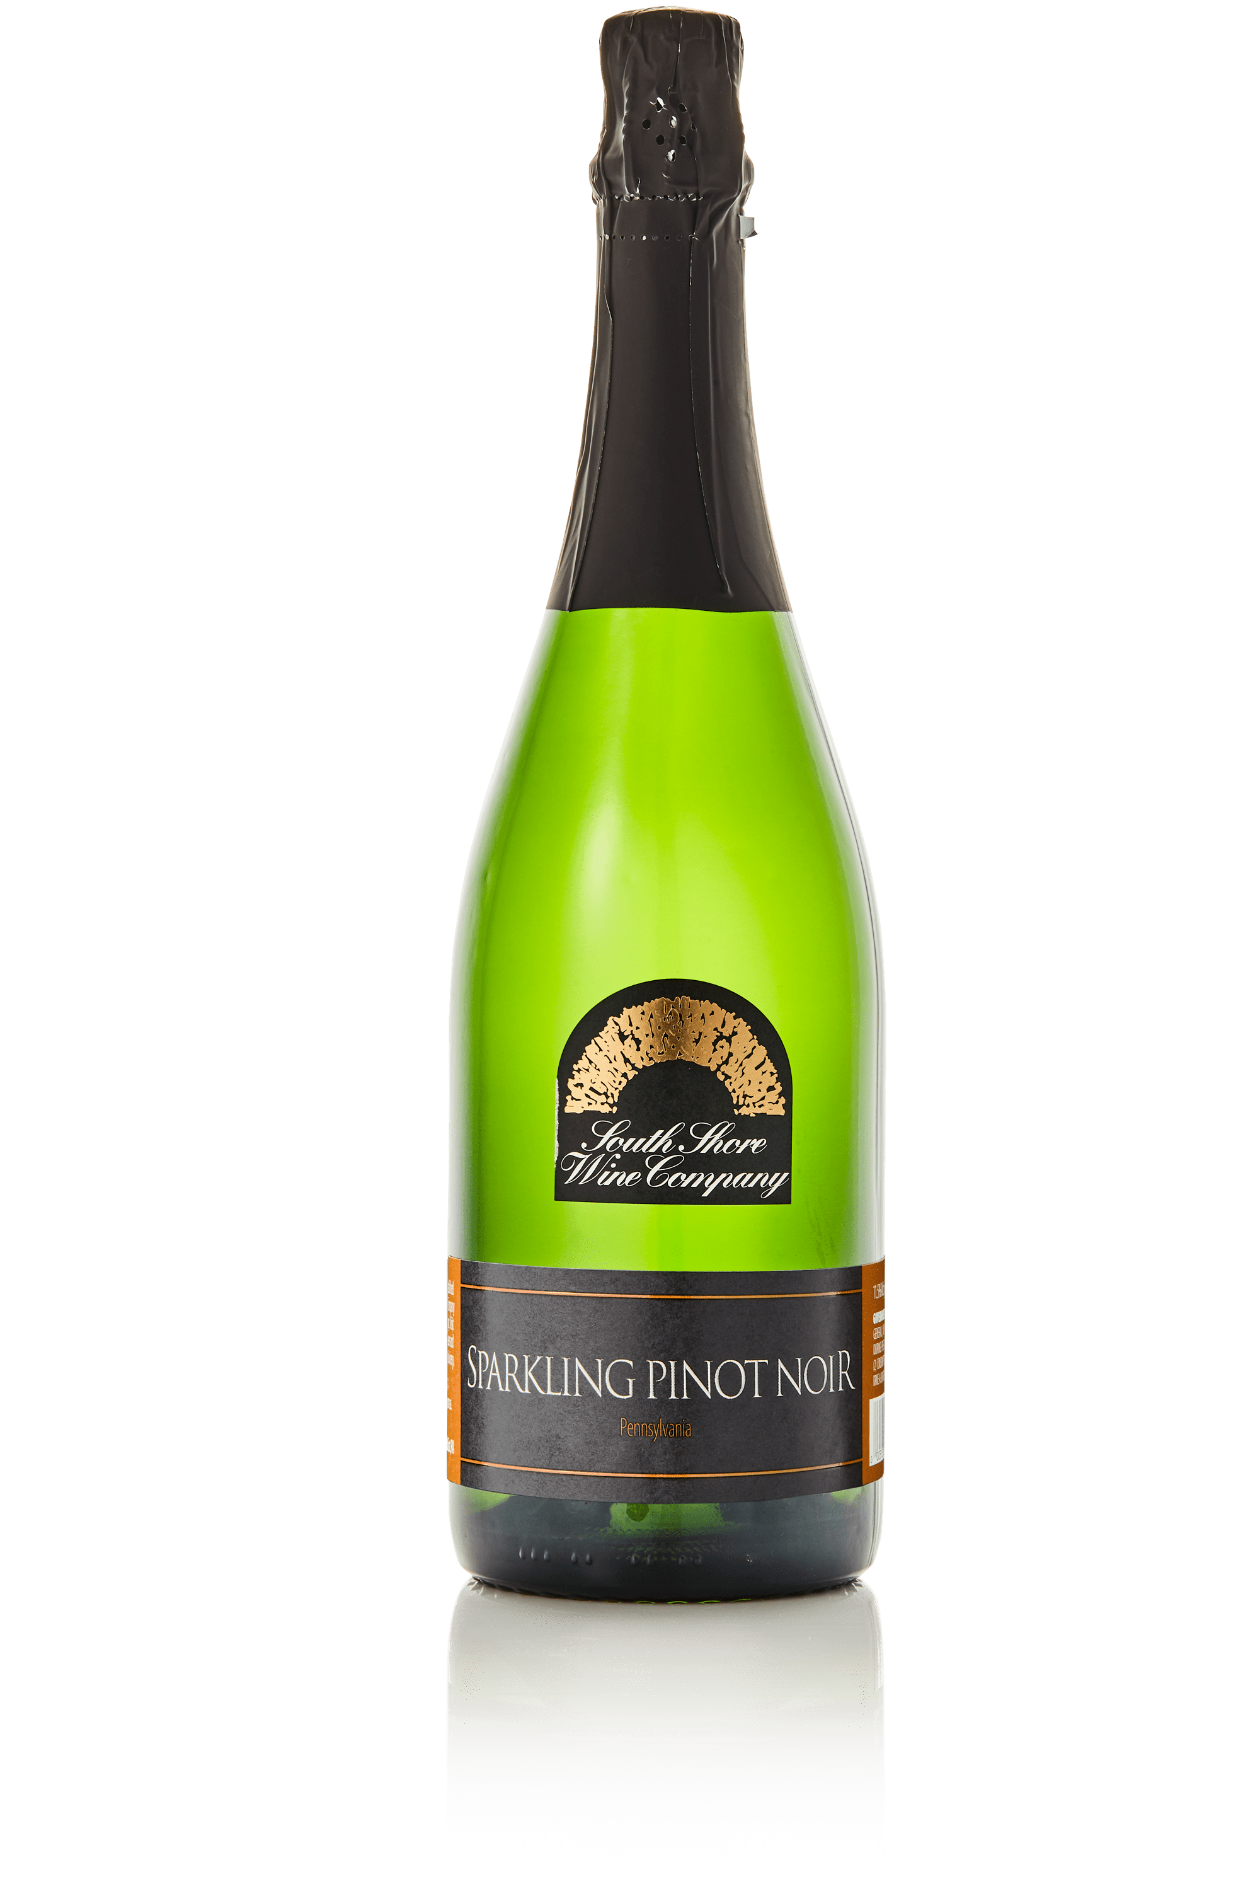
Vintage: Non-Vintage
Appellation: Pennsylvania
Residual Sugar: 0% Alcohol: 12%
Varieties: Pinot Noir (100%) Winemaking/Ferment notes: This wine is bottle fermented using the Méthode Champenoise (traditional method). On the palate of our Sparkling Pinot Noir you will find concentrated fruit of black cherry and ripe plum. This wine’s medium acidity leads to a perfectly balanced dry and fragrant finish.
Cellaring potential: 1-3 years
pH: 3.20 TA: 7.10 g/L
Vineyards: Cortenay Semelka Vineyards Food pairing(s): Lamb loin chops; Garlic prime rib; Grilled Portobello Mushrooms Dietary notes: Vegan, Gluten-free

Slide 30
From the mid 1900’s to the present day a rich sparkling tradition continues in our region. Our cool climate produces wines that are acid driven, and light in body and ABV. Wines of this nature are perfect base wines for sparkling representations.
As our region continues to grow and gain recognition look for more world class sparkling wines to enjoy yourself and share with all of you guests.

Slide 31
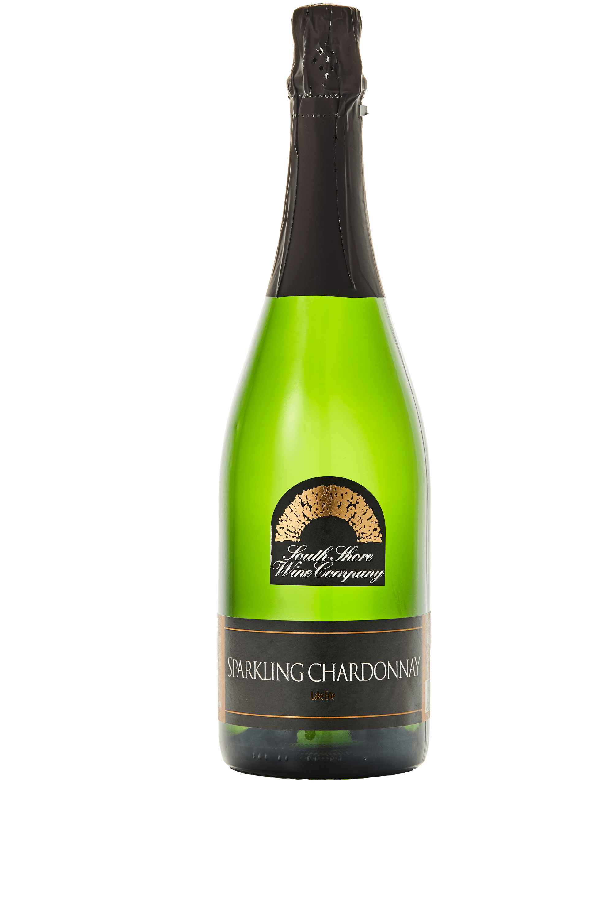
Vintage: Non-Vintage
Appellation: Lake Erie
Residual Sugar: 0% Alcohol: 12%
Varieties: Chardonnay (100%)
Winemaking/Ferment notes: Our Sparkling Chardonnay is bottle fermented using the Méthode Champenoise. The wine is dry and sophisticated. This wine’s medium acidity leads to a perfectly delicate crisp finish.
Cellaring potential: Best consumed young
pH: 3.14 TA: 8.1 g/L
Vineyards: Moorhead Farms
Food pairing(s): Shellfish, smoked salmon, Oysters, and Fois Gras

Slide 32
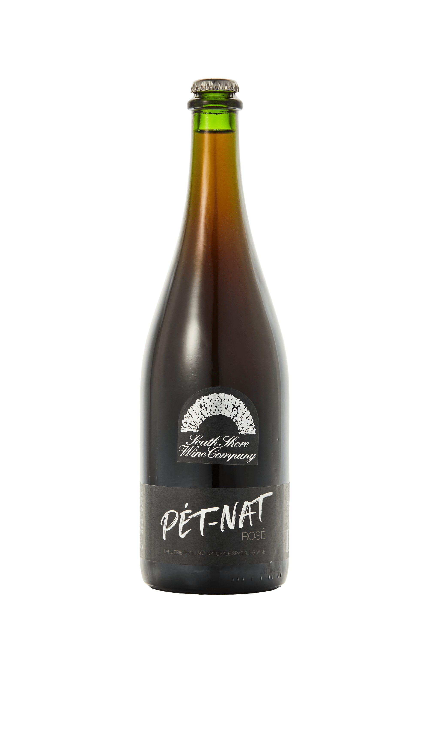
Vintage: Non-Vintage
Appellation: Lake Erie
Residual Sugar: 0.3%
Alcohol: 12%
Varieties: Chambourcin (100%)
Winemaking/Ferment notes: This Chambourcin pressed rosé base was bottled when partially fermented, in the Pétillant Naturel method, creating natural carbonation. A slightly darker press fraction gives intense color and a bit more robust flavor. Some lees and sediment remain, chill upright if you’d like to control the sediment before serving.
Cellaring potential: Enjoy young, also benefits from careful cellaring
pH: 3.65 TA: 4.7 g/L
Vineyards: Various vineyards in the Lake Erie region

Slide 33
CHEERS!!
BLAINE BALLARD
blaine@mazzawines.com

